Slide 1
Logic Circuits

Slide 2
You’ve been told Logic is the Language of Computers?
So should I be worried about Terminator?

Slide 3
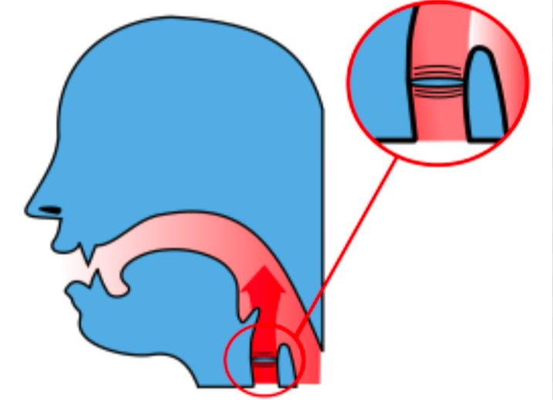
How do we (humans) speak?
We make complicated vibrations by passing air past our vocal cords to represent lingual codex (such as words and sentences)

Slide 4
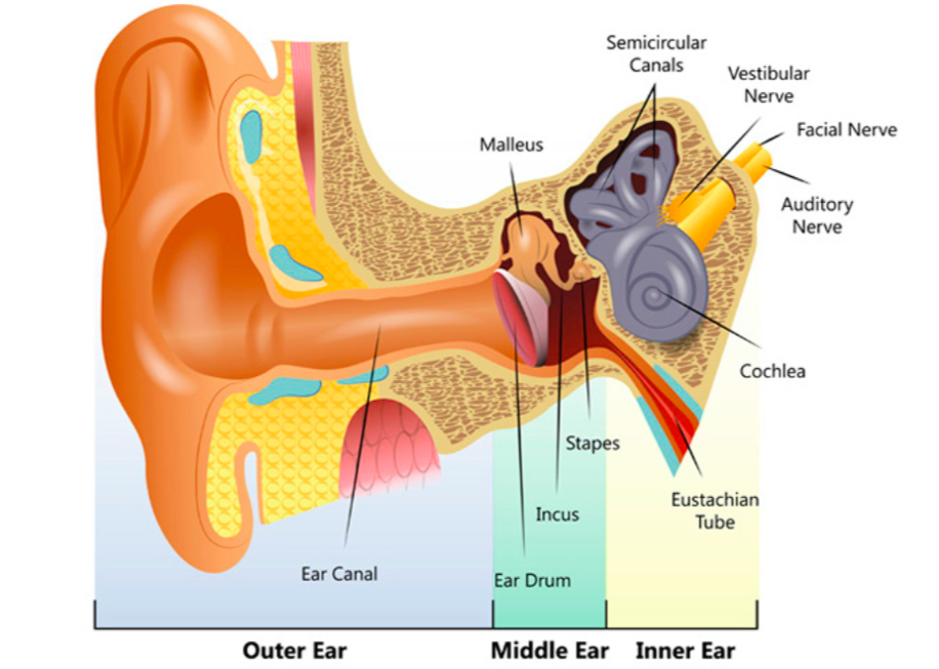
How do we (humans) listen?
… then our ears convert these vibrations into electrical and chemical signals which get sent to our brain for interpretation ...

Slide 5
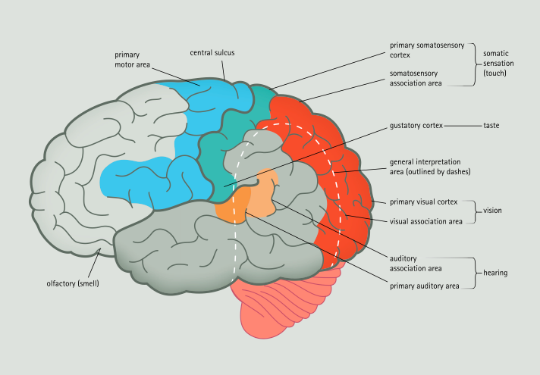
How do we (humans) interpret?
We then classify this linguistic code, such as we have in this course, by considering smaller statements as either true or false then using connectives ...

Slide 6
How do Computers speak?
They only know two words TRUE and FALSE

Slide 7
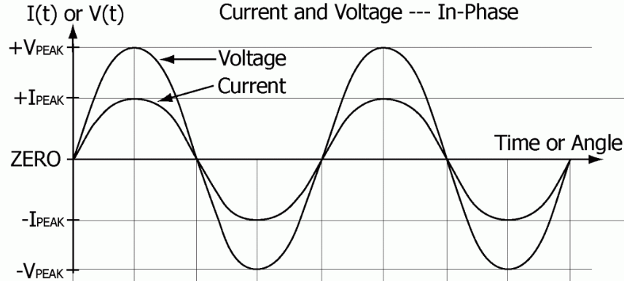
How do Computers speak?
As we encode our language with vibrations through air, they send different voltages across circuit boards and wires
(+ =True, - =False)

Slide 8
How do Computers interpret?
Computers DO NOT interpret, you can think of the smallest “parts” of a computer as always listening and then yelling what it hears!

Slide 9
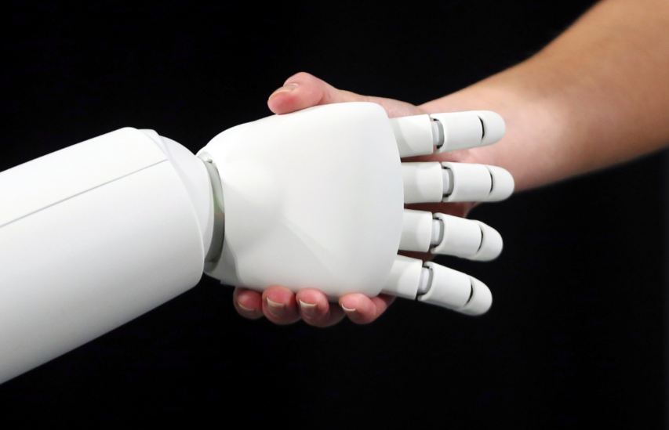
How do Computers interpret?
So we build circuits to interpret for them… so they hear and yell what we want!

Slide 10
0 and 1’s?
Instead of true (T) or false (F)
When we “speak Computer” we write 1 and 0
1 = T
0 = F

Slide 11
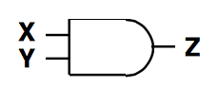
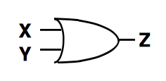
How do we draw the Circuits?
AND
OR
NOT

Slide 12
Example Alarm:
Search for the 1
(That is the TRUTH)
The first machine
1. Porch Sensor
This machine “hears” a 1 when someone is on my porch, and “yells” 1 when this happens,
otherwise it “hears” a 0 and yells a 0
This can be thought of as the statement:
P=“Someone is on my porch”

Slide 13
Example Alarm:
The second machine
2. Window Sensor
This machine “hears” a 1 when my window is not broken, and “yells” 1 when this happens,
otherwise it “hears” a 0 and yells a 0 (that is when it is broken)
This can be thought of as the statement:
W=“My Window is not broken”

Slide 14
Example: ALARMS (great example for yelling)
The third machine
3. Alarm
When this machine “hears” a 1 it turns the annoying loud alarm on
When this machine “hears” a 0 it keeps the annoying loud alarm off
This can be thought of as the statement:
A=“Alarm is on”

Slide 15
Recall:
We want the alarm on when:
Someone is on my porch or my window is broken

Slide 16
Recall:
Given: P=“Someone is on my porch” (this is what the porch sensor “says”)
W=“My window is not broken” (this is what the window sensor “says”)
Write the following sentence using logic symbols:
Someone is on my porch, or my window is broken

Slide 17
Recall:
AND
OR
NOT

Slide 18
Recall:
OR
NOT

Slide 19
Example: ALARMS (great example for yelling)
We want to design a circuit so that these machines will “talk” to each other, and turn the alarm on when ever someone is on my porch, or they break my window...
Now to CHECK that it works:
P
W
A=
1
1
1
1
0
1
0
1
0
0
0
1

Slide 20
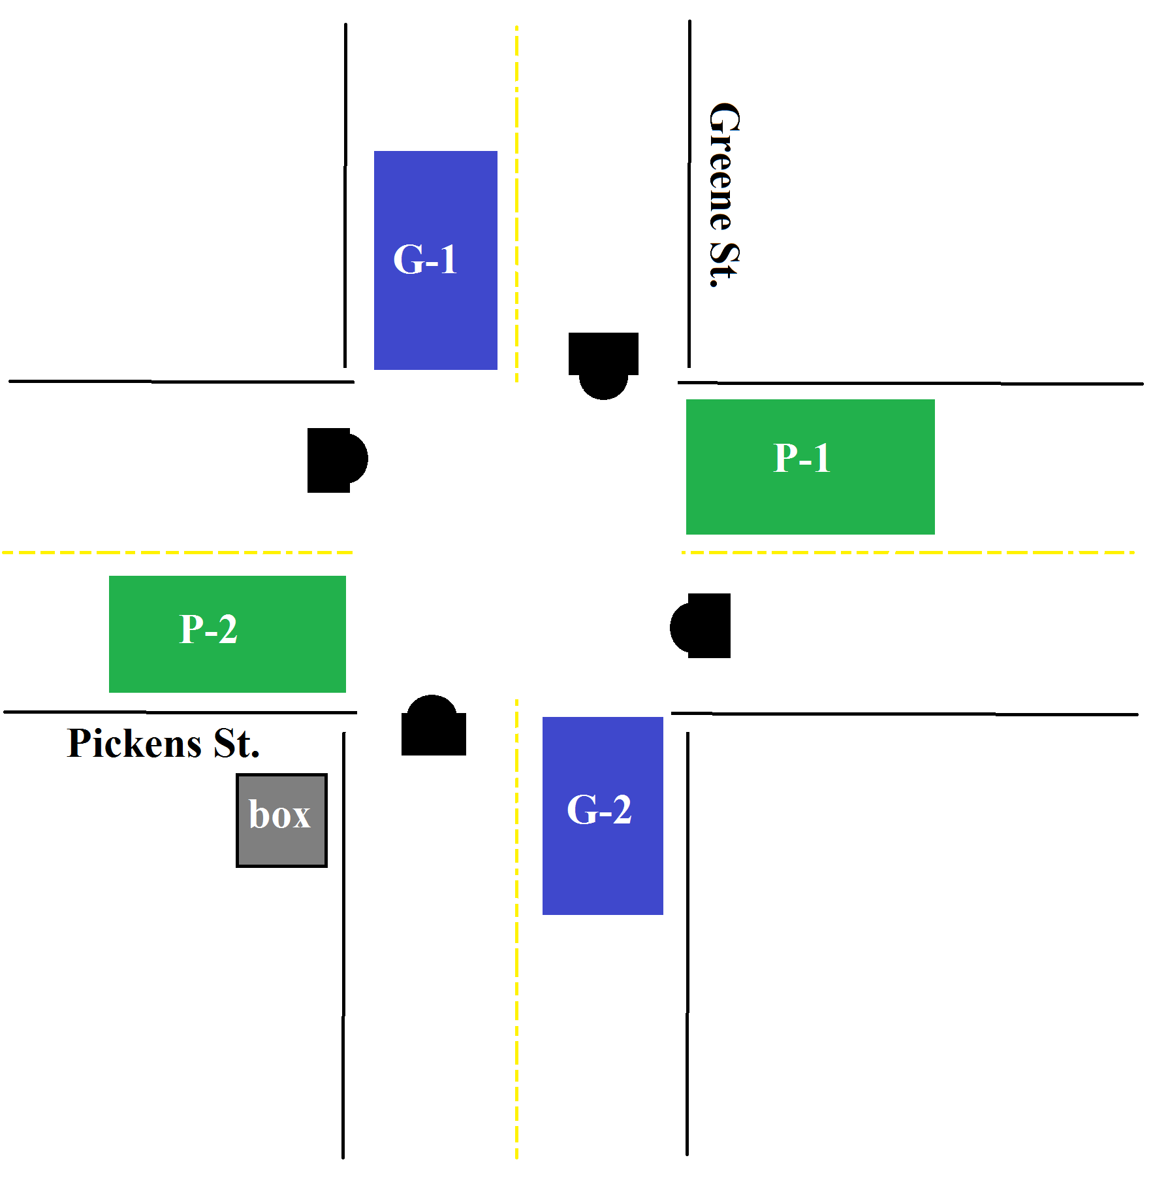
Group Work: Greene St. Renovations

Slide 21
Group Work: Greene St. Renovations
At the intersection of Greene St. and Pickens St. there are four sensors each send a 1 if there is a car there, if the box recieves a 1 it will make Greene St. a green light and Pickens St. a red light and for a zero the opposite. If there is a car at atleast one sensor of either street then that streets signal should turn green, also since Pickens is a buiser road, it should get first priority (that is if there is no cars Pickens St. should be green, and if there is a car at both streets Pickens St. should be green. Make the corresponding circuit which will achieve this.

Slide 22
Group Work:
A power plant has an alarm system where it goes off when the water tank sensor is at a low level, at which the sensor produces a 0 (for low level), or if the fan malfunctions, (again the fan sensor produces a 0 for broken), or if the heat is too high at which the heat sensor produces a 1. Create the proper circuit, if the alarm takes in a 1 to sound.

Slide 23
Group Work:
Create your own problem that uses one of at least each gate.

